Slide 1
The 7 habits of highly successful collaborative research scientists

Slide 2
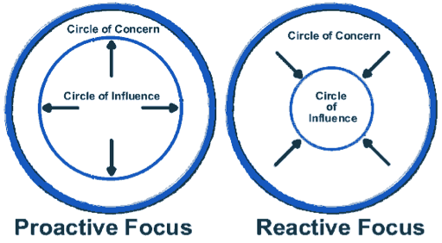
Habit 1: Be proactive
What does it mean to be proactive?
How does the language we use reflect our proactivity or reactivity?
What do we have direct, indirect and no control over

Slide 3
The serenity prayer
God, grant me the serenity to accept the things I cannot change
The courage to change the things I can
And the wisdom to know the difference

Slide 4
Predicting responses of pests to global warming
The value of making such sweeping global predictions
A generalized mechanistic model for insect responses to global change
What did we learn?
This week’s paper:
https://www.butterflyinformatics.org/sites/default/files/13%20Sept%20Reading.pdf

Slide 5
The model is built around this relationship and global pattern:
Typical metabolic rate equation: 3/4 rule, Boltzmann’s constant, and species-specific activation energy (Eo)
Crop change rate = metabolism change rate + population growth rate
Metabolism:
Population growth rate:
A more formal equation
where r is a function of temperature and species-specific rmax, Topt, CTmax
Species/crop specific rates or just mean and variance for all insect (or insect pests)?

Slide 6
What did they compute?
Questions:
Did they use one mean value to represent all insect pests or were they crop specific (yes?)
How did they consider regional heat stress or advantage for crops – or crop switches (didn’t?) – discussion mentions increased pressure on farmers to adapt
They consider diapause – what other factors of insect life history may be important?

Slide 7
Spatial patterns of loss/gain – crop gains (temperate) offset by herbivory?

Slide 8
Regional implications

Slide 9
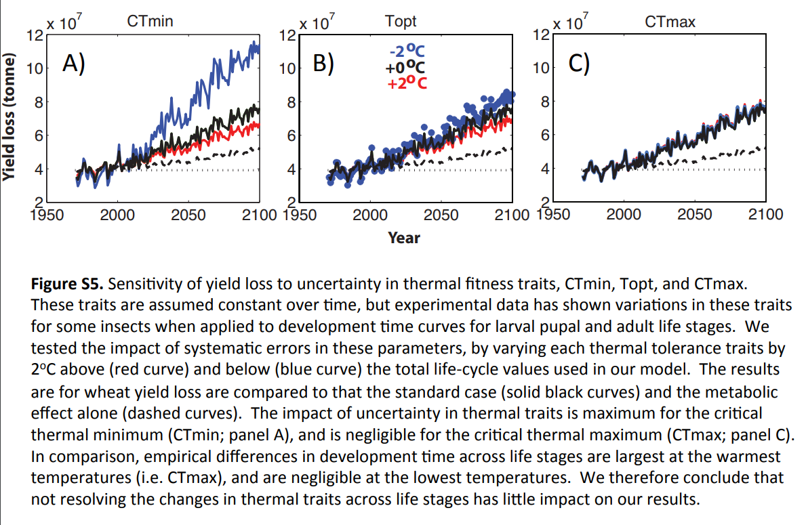
Lots of interesting sensitivity analyses

Slide 10
More sensitivity

